Slide 1
Analysing Communication
Analysing Communication
© Karsten Pedersen

Slide 2
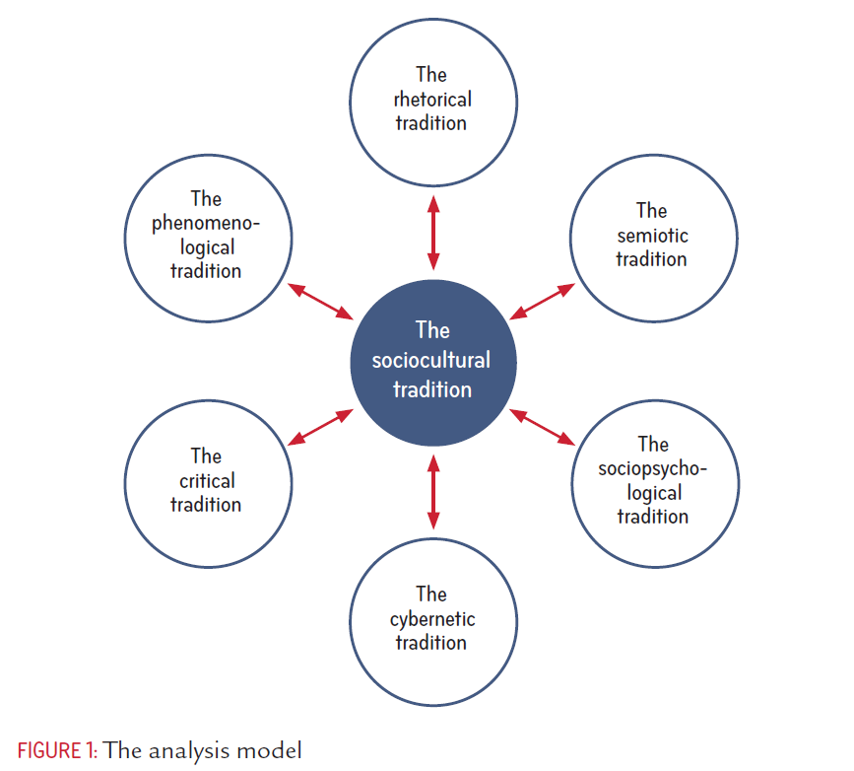
Analysing Communication
© Karsten Pedersen

Slide 3
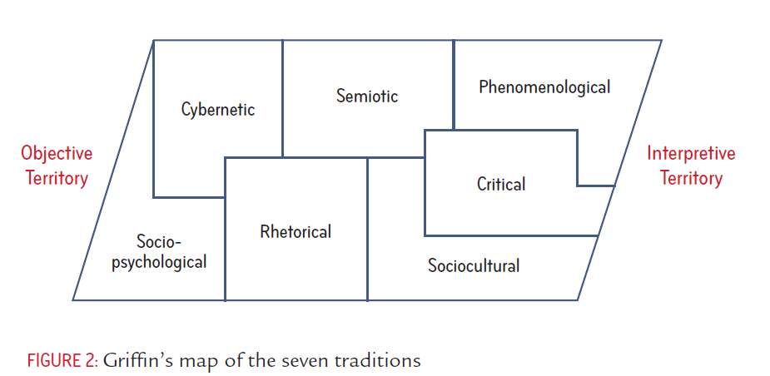
Analysing Communication
© Karsten Pedersen

Slide 4
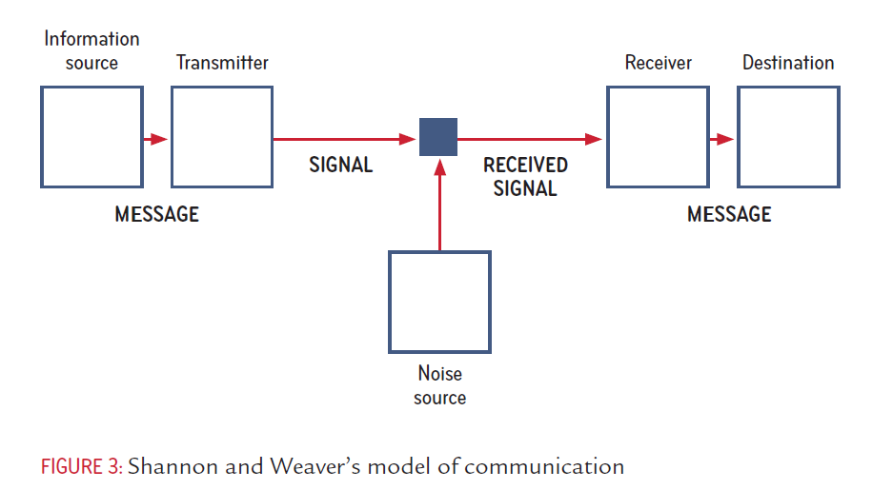
Analysing Communication
© Karsten Pedersen

Slide 5
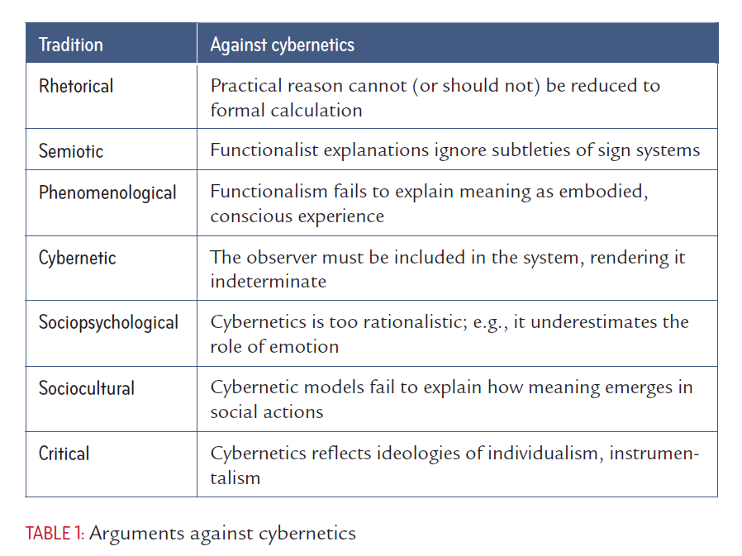
Analysing Communication
© Karsten Pedersen

Slide 6
Analysing Communication
© Karsten Pedersen

Slide 7
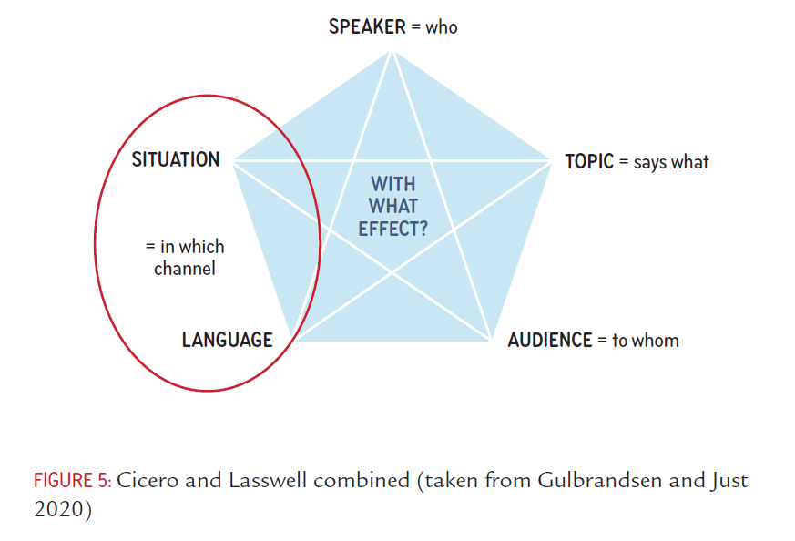
Analysing Communication
© Karsten Pedersen

Slide 8
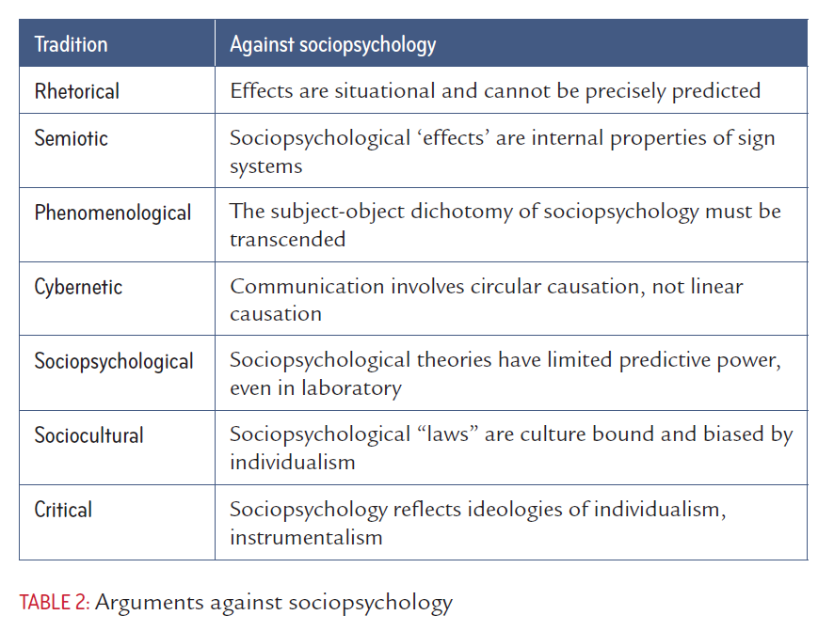
Analysing Communication
© Karsten Pedersen

Slide 9
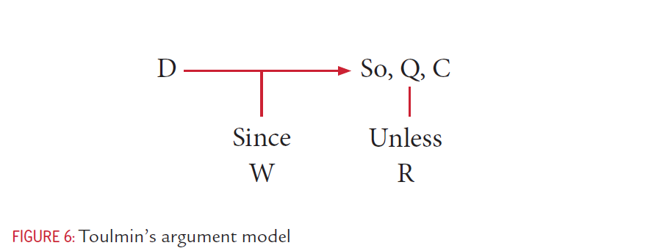
Analysing Communication
© Karsten Pedersen

Slide 10
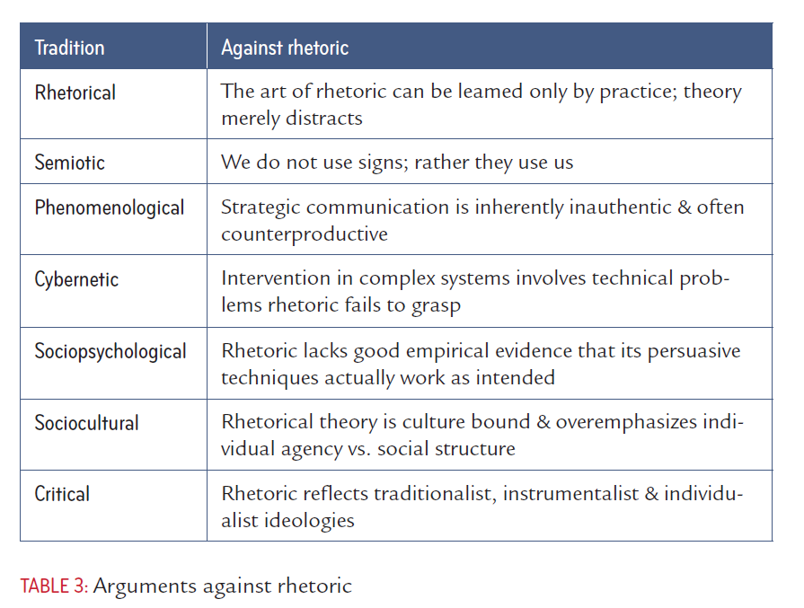
Analysing Communication
© Karsten Pedersen

Slide 11
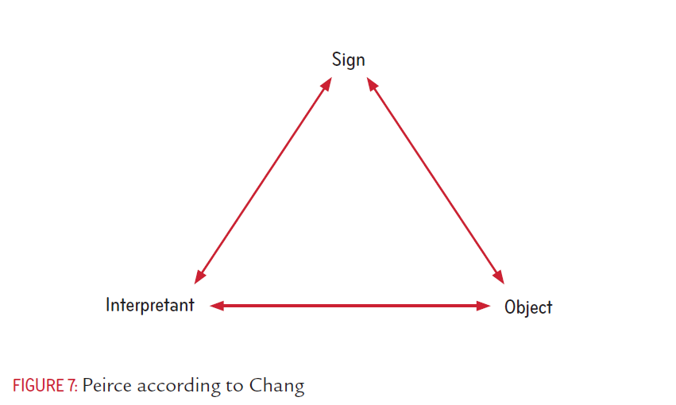
Analysing Communication
© Karsten Pedersen

Slide 12
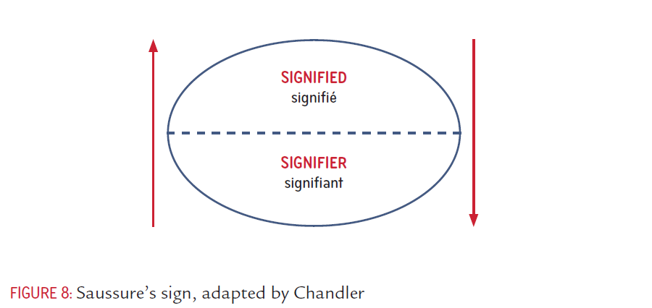
Analysing Communication
© Karsten Pedersen

Slide 13
Analysing Communication
© Karsten Pedersen

Slide 14
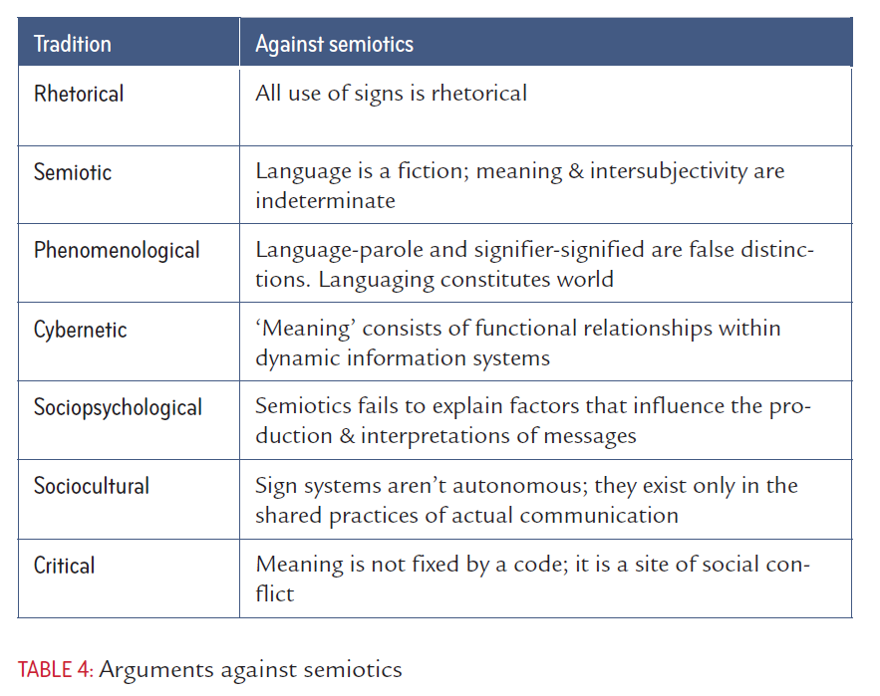
Analysing Communication
© Karsten Pedersen

Slide 15
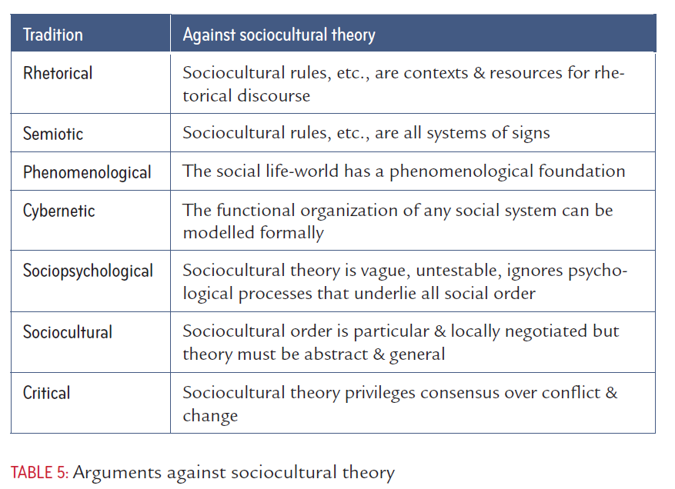
Analysing Communication
© Karsten Pedersen

Slide 16
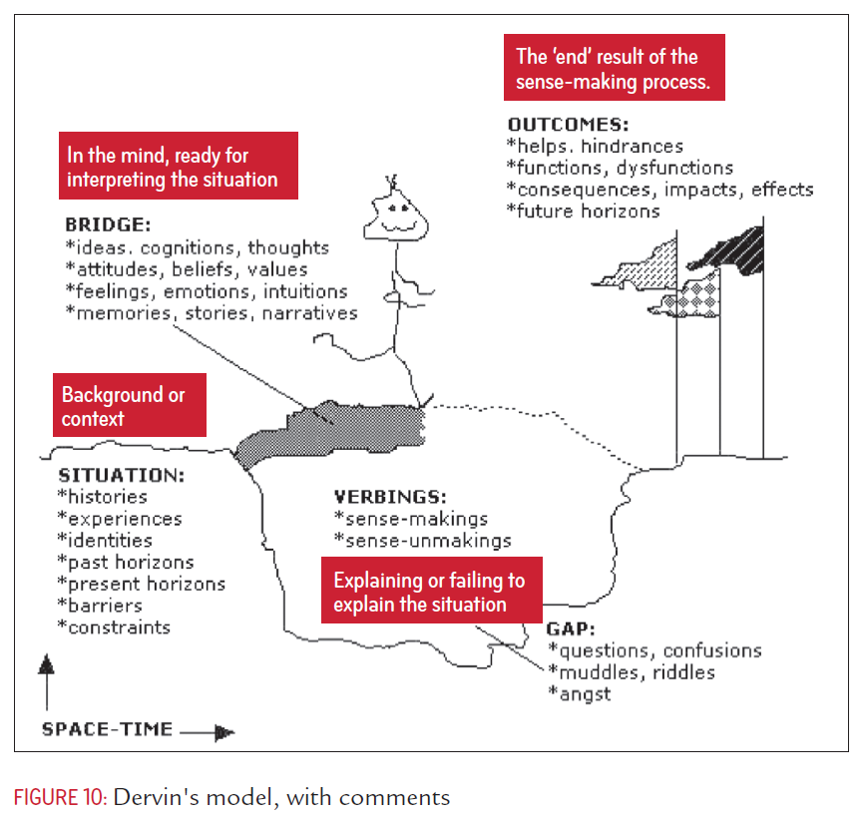
Analysing Communication
© Karsten Pedersen

Slide 17
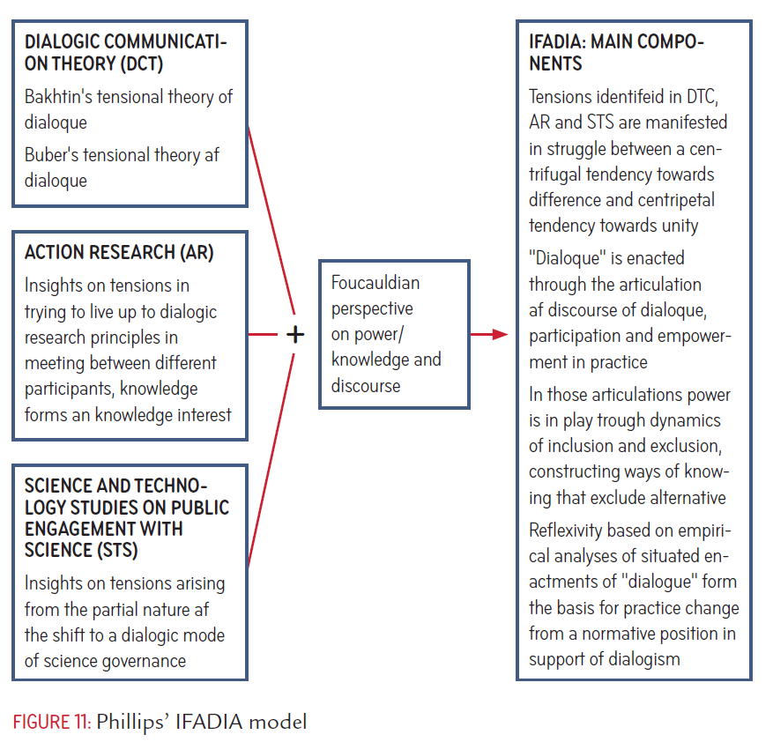
Analysing Communication
© Karsten Pedersen

Slide 18
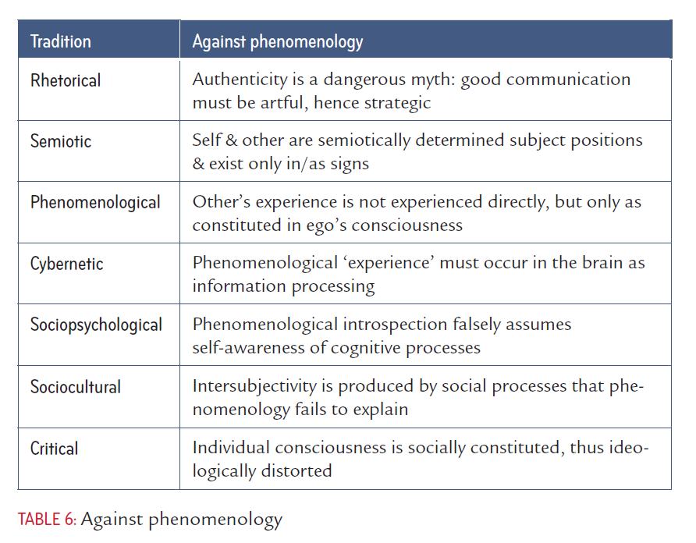
Analysing Communication
© Karsten Pedersen

Slide 19
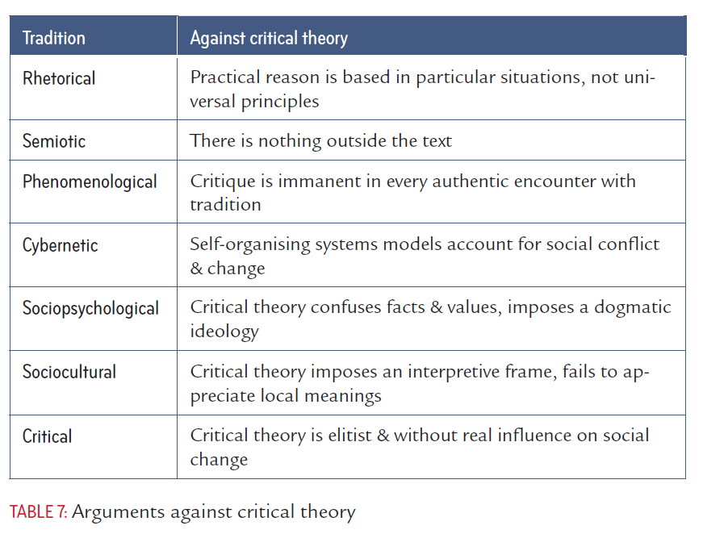
Analysing Communication
© Karsten Pedersen

Slide 20
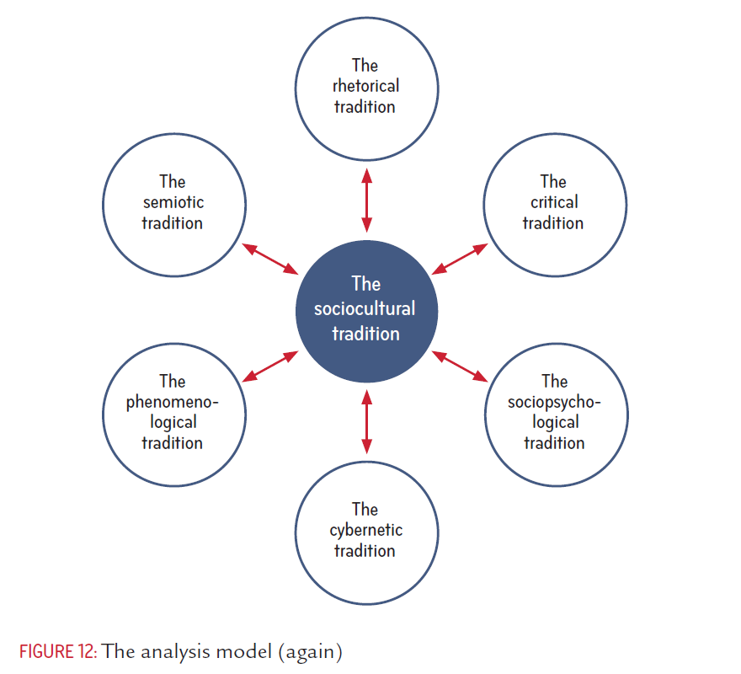
Analysing Communication
© Karsten Pedersen

Slide 21
Analysing Communication
© Karsten Pedersen

