Slide 1
Mikroøkonomi Introduktion til teorier og praksis
Mikroøkonomi
© Rune Peter Wingård

Slide 2
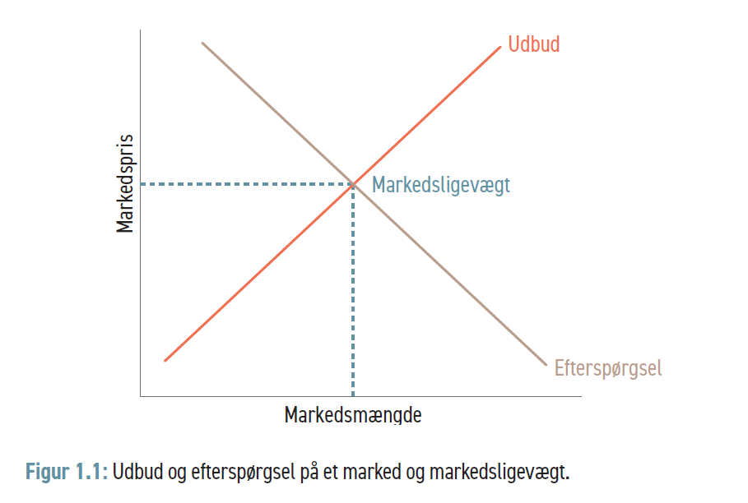
Mikroøkonomi
© Rune Peter Wingård

Slide 3
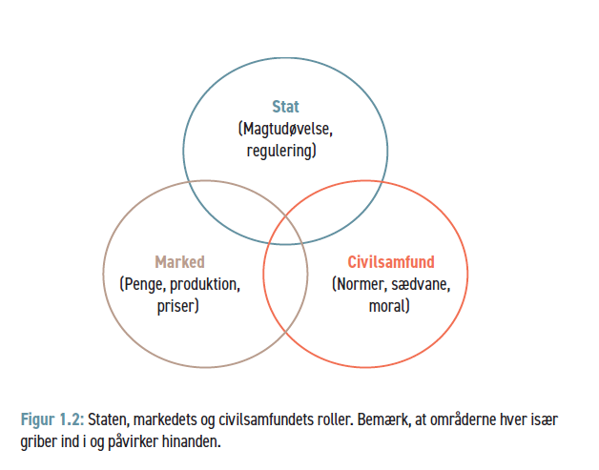
Mikroøkonomi
© Rune Peter Wingård

Slide 4
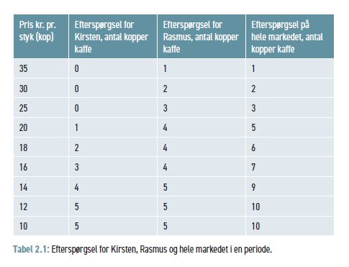
Mikroøkonomi
© Rune Peter Wingård

Slide 5
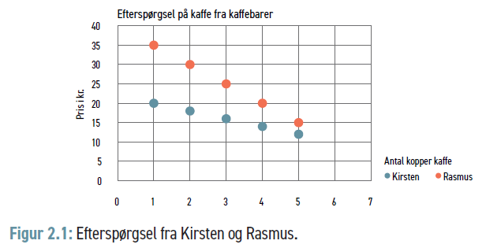
Mikroøkonomi
© Rune Peter Wingård

Slide 6
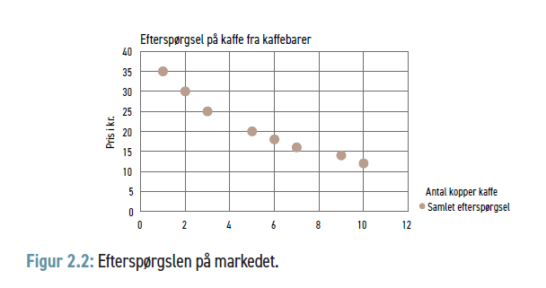
Mikroøkonomi
© Rune Peter Wingård

Slide 7
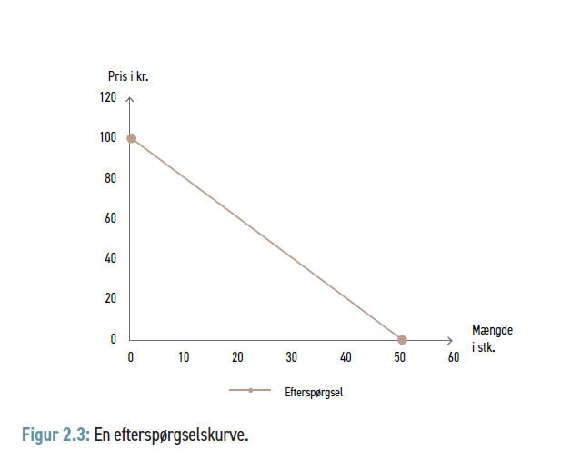
Mikroøkonomi
© Rune Peter Wingård

Slide 8
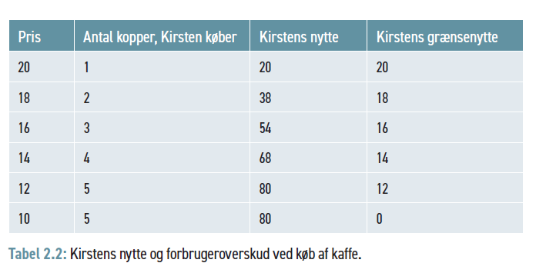
Mikroøkonomi
© Rune Peter Wingård

Slide 9
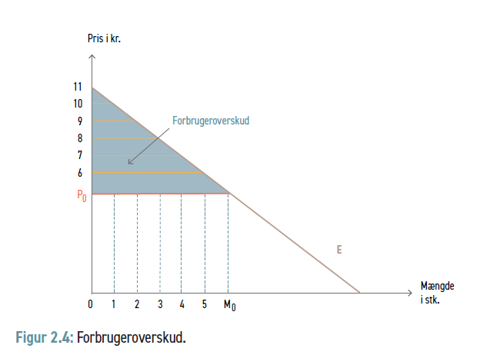
Mikroøkonomi
© Rune Peter Wingård

Slide 10
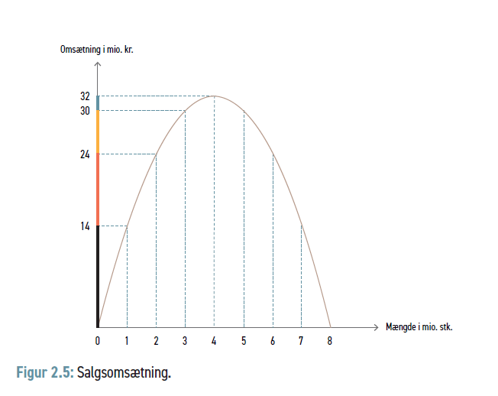
Mikroøkonomi
© Rune Peter Wingård

Slide 11
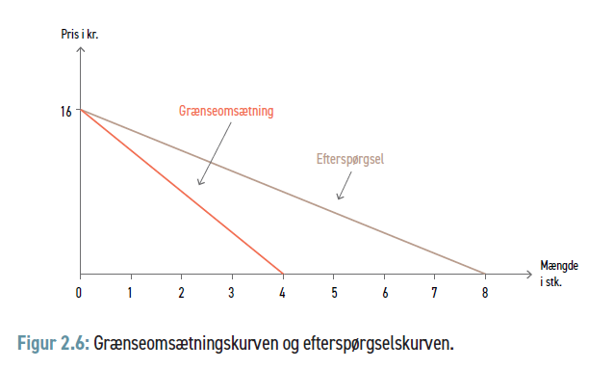
Mikroøkonomi
© Rune Peter Wingård

Slide 12
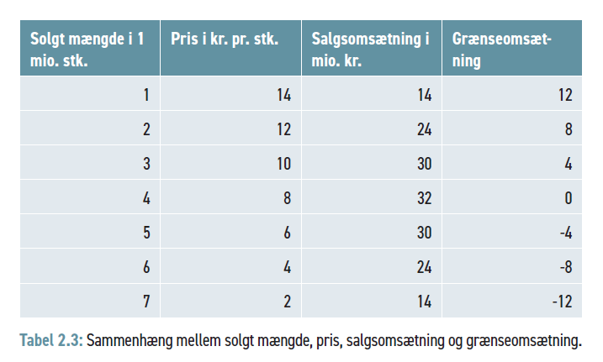
Mikroøkonomi
© Rune Peter Wingård

Slide 13
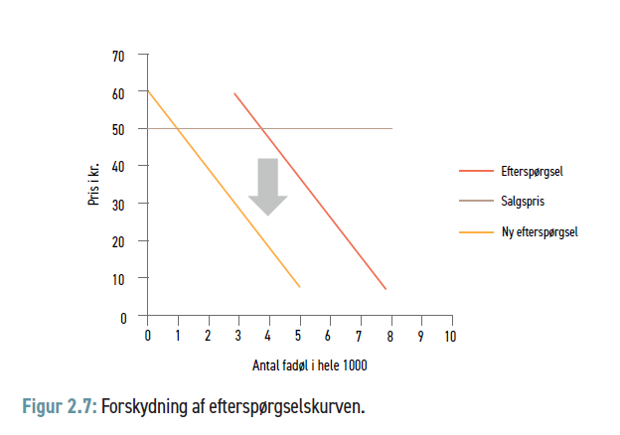
Mikroøkonomi
© Rune Peter Wingård

Slide 14
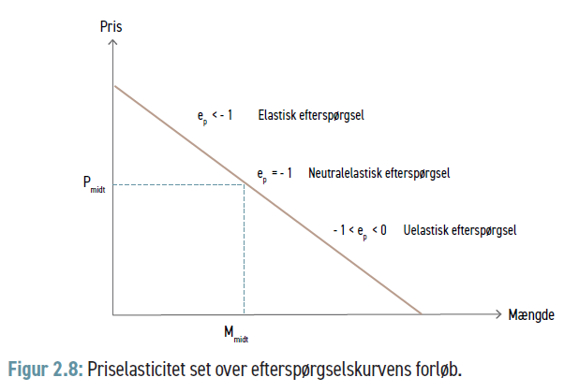
Mikroøkonomi
© Rune Peter Wingård

Slide 15
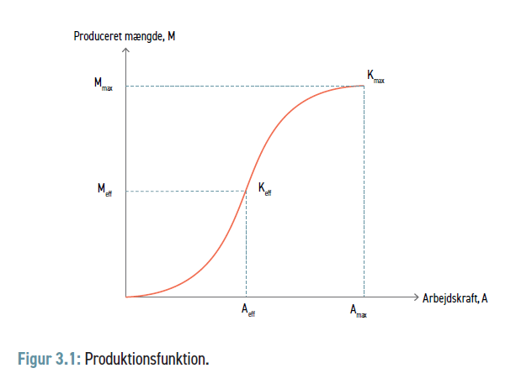
Mikroøkonomi
© Rune Peter Wingård

Slide 16
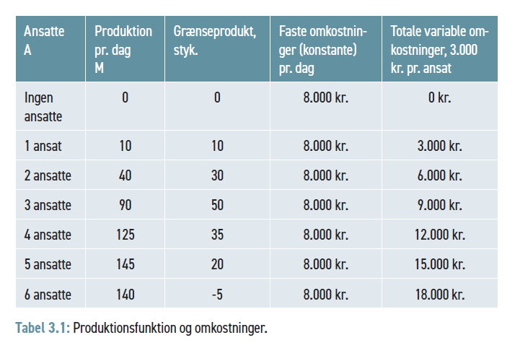
Mikroøkonomi
© Rune Peter Wingård

Slide 17
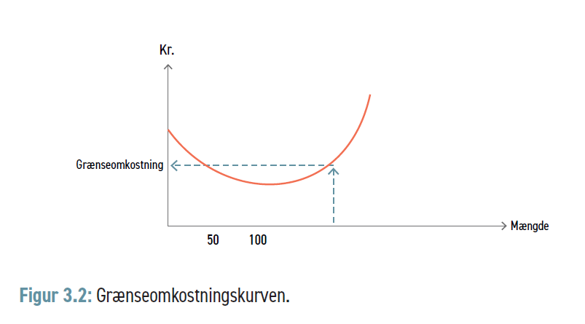
Mikroøkonomi
© Rune Peter Wingård

Slide 18
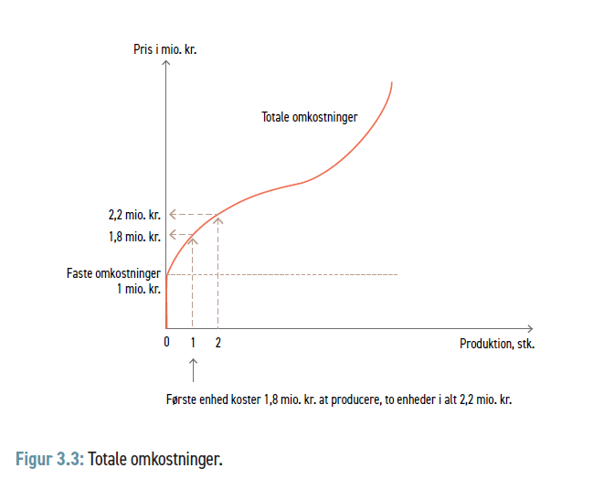
Mikroøkonomi
© Rune Peter Wingård

Slide 19
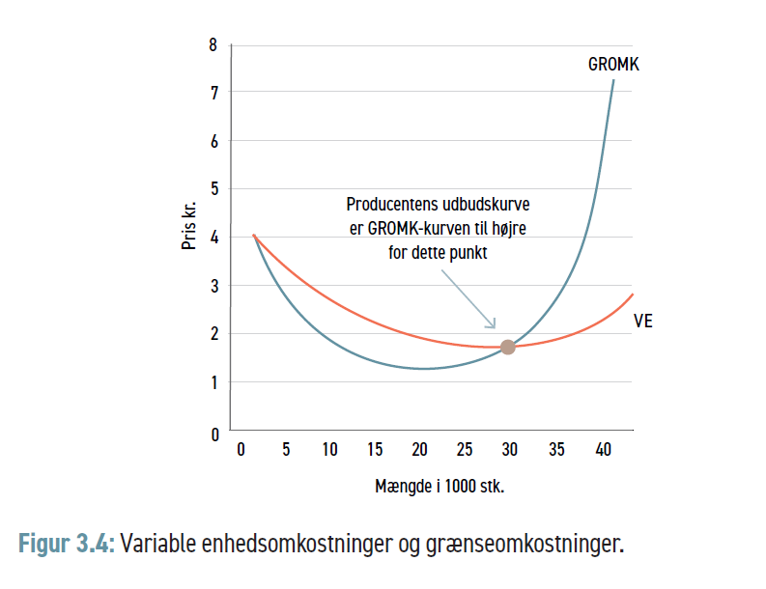
Mikroøkonomi
© Rune Peter Wingård

Slide 20
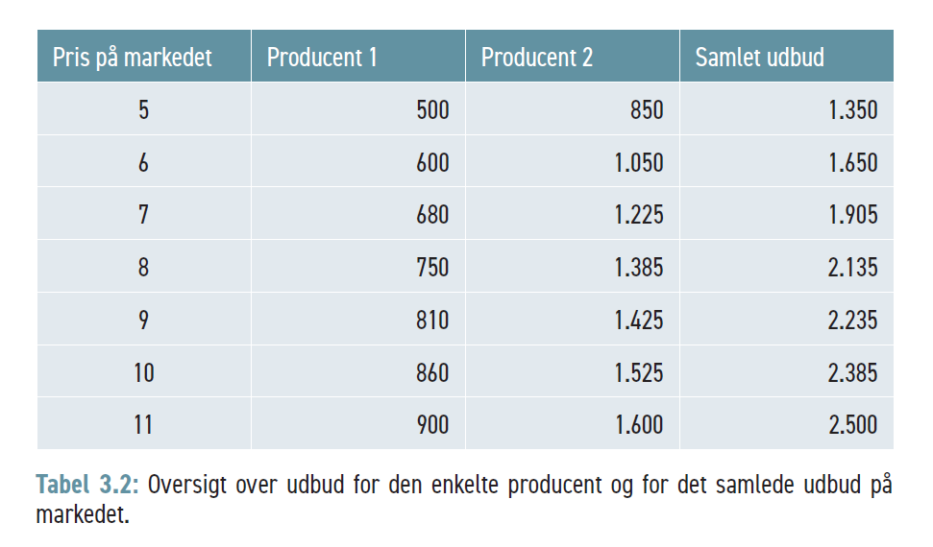
Mikroøkonomi
© Rune Peter Wingård

Slide 21
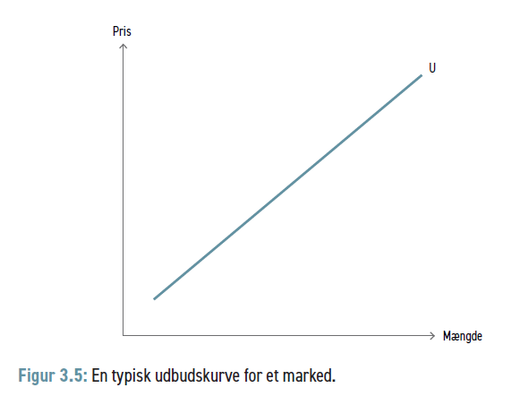
Mikroøkonomi
© Rune Peter Wingård

Slide 22
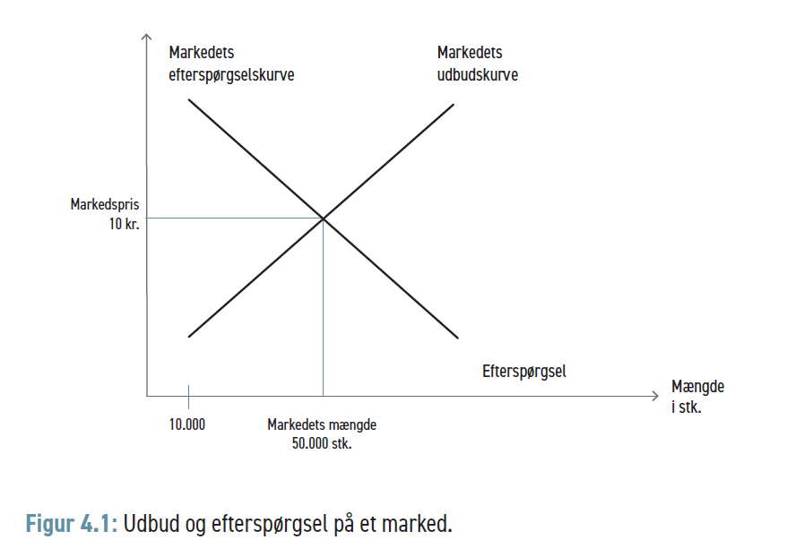
Mikroøkonomi
© Rune Peter Wingård

Slide 23
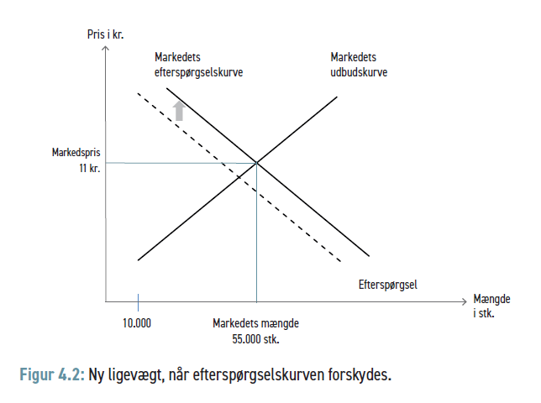
Mikroøkonomi
© Rune Peter Wingård

Slide 24
Mikroøkonomi
© Rune Peter Wingård

Slide 25
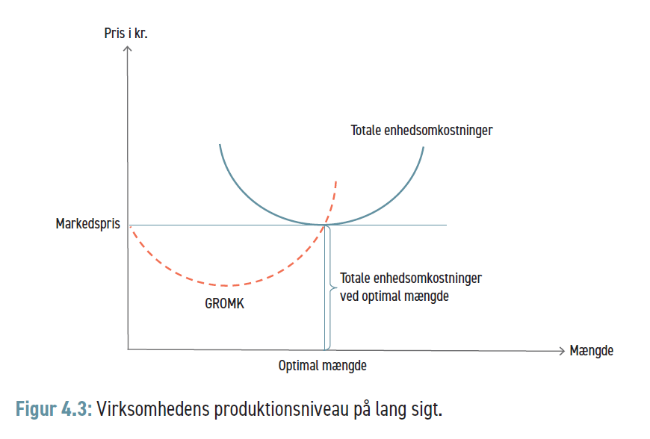
Mikroøkonomi
© Rune Peter Wingård

Slide 26
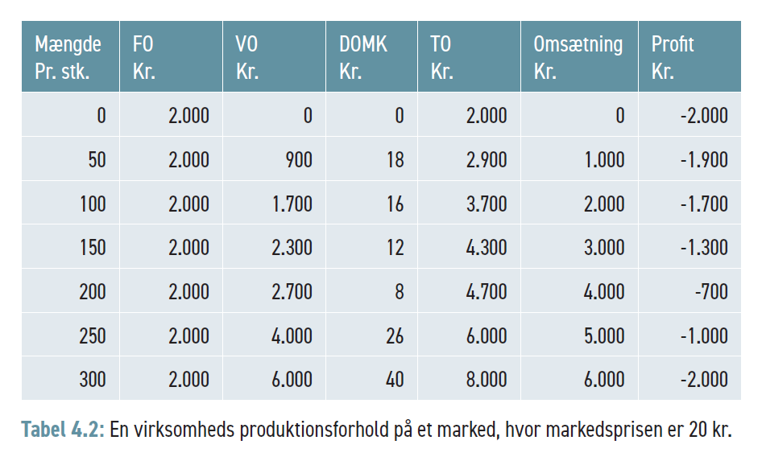
Mikroøkonomi
© Rune Peter Wingård

Slide 27
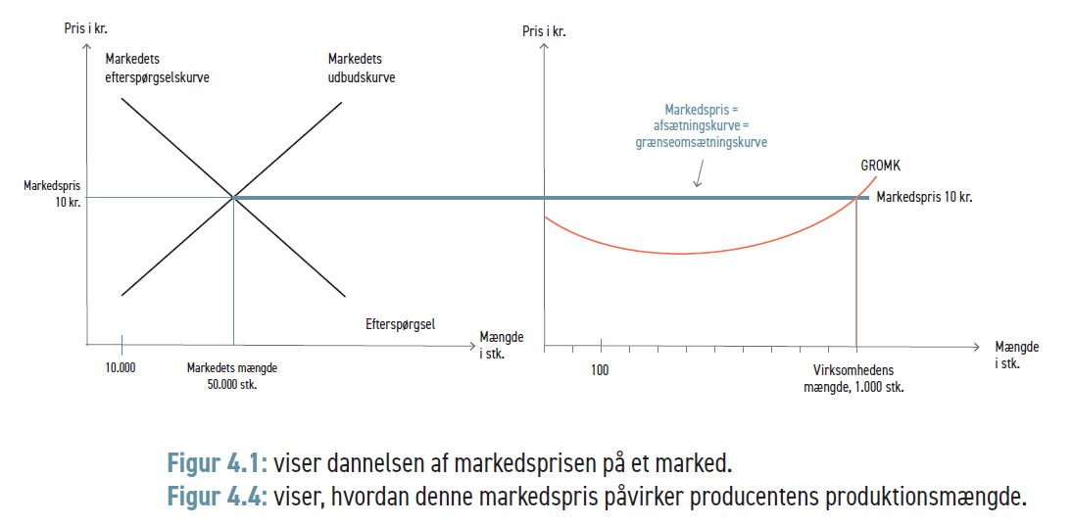
Mikroøkonomi
© Rune Peter Wingård

Slide 28
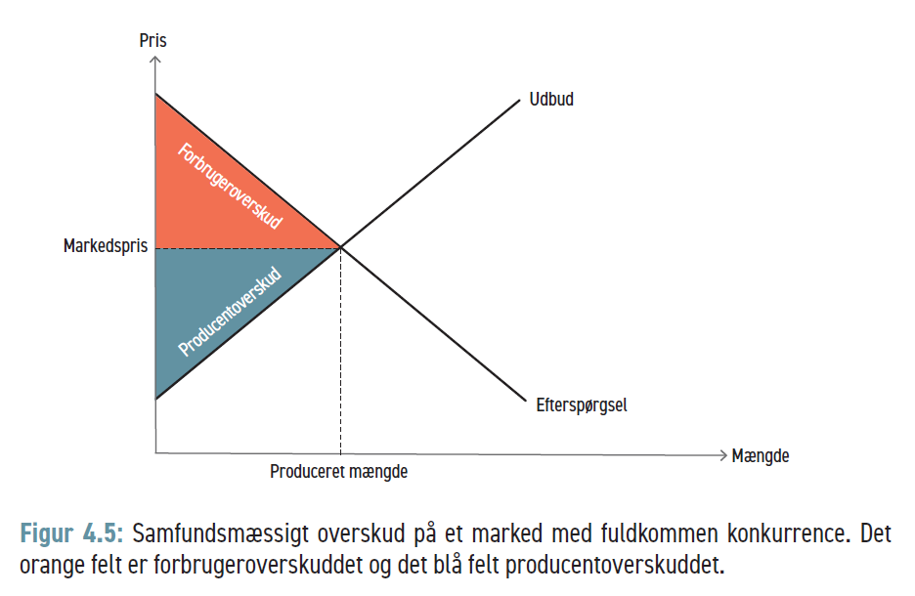
Mikroøkonomi
© Rune Peter Wingård

Slide 29
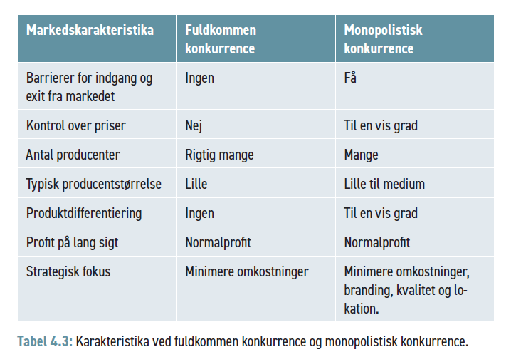
Mikroøkonomi
© Rune Peter Wingård

Slide 30
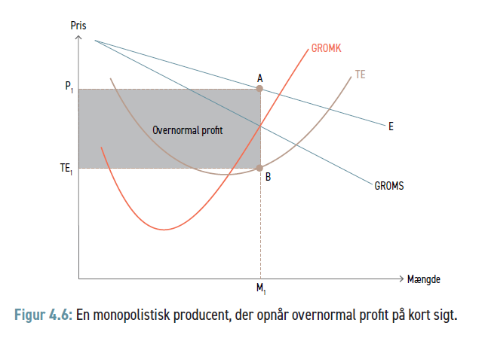
Mikroøkonomi
© Rune Peter Wingård

Slide 31
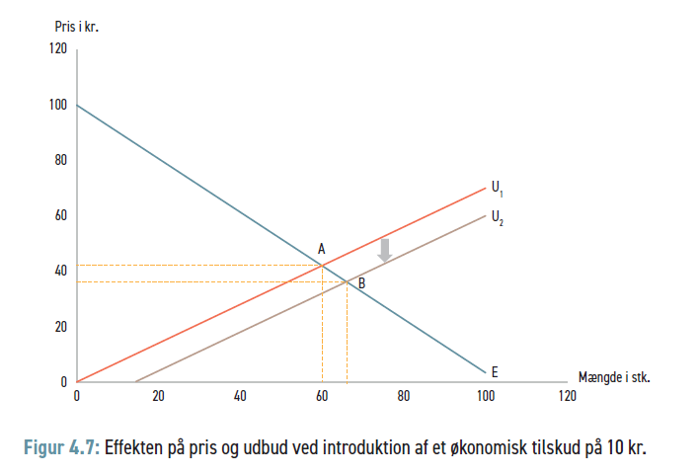
Mikroøkonomi
© Rune Peter Wingård

Slide 32
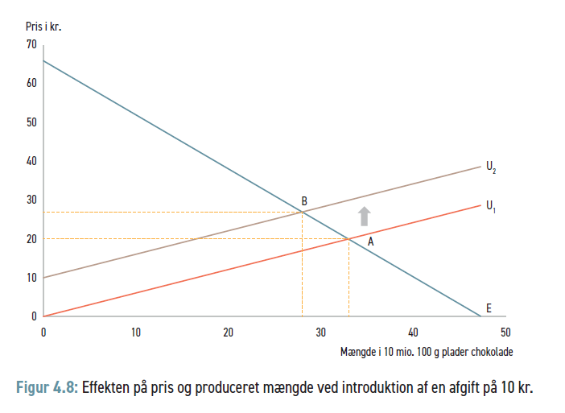
Mikroøkonomi
© Rune Peter Wingård

Slide 33
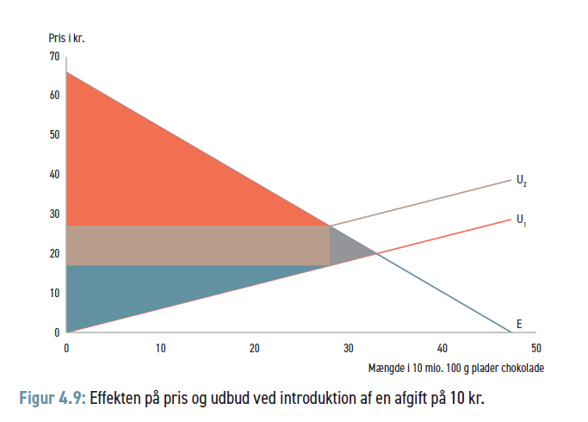
Mikroøkonomi
© Rune Peter Wingård

Slide 34
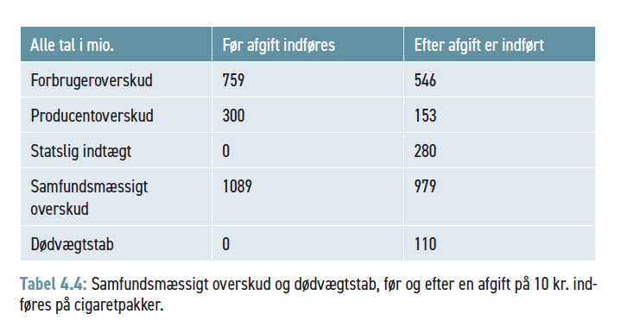
Mikroøkonomi
© Rune Peter Wingård

Slide 35
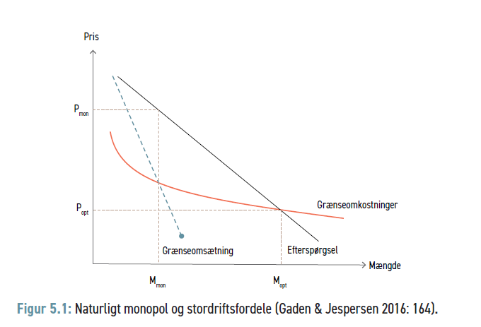
Mikroøkonomi
© Rune Peter Wingård

Slide 36
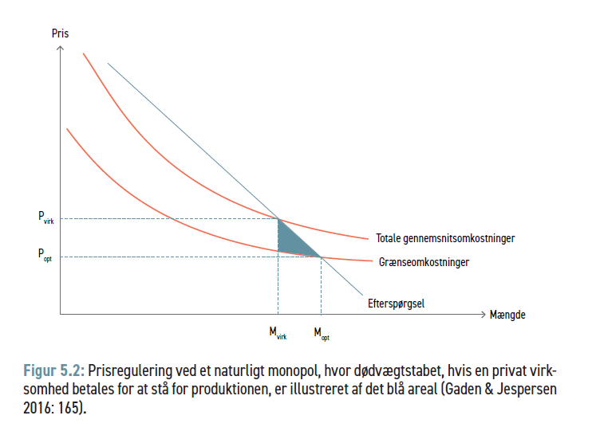
Mikroøkonomi
© Rune Peter Wingård

Slide 37
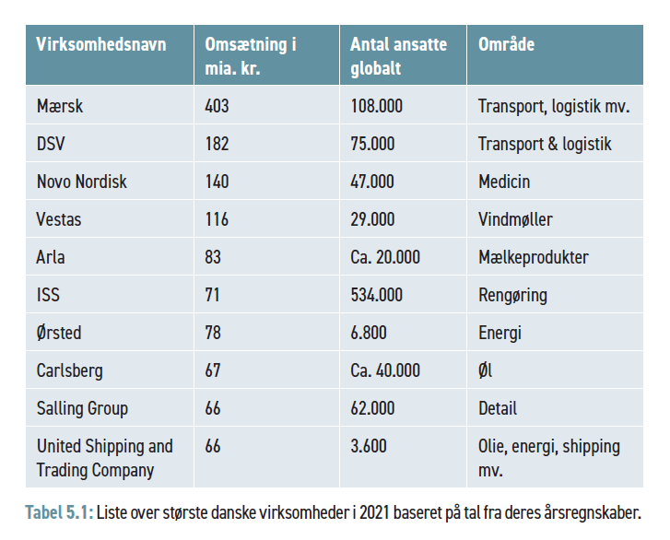
Mikroøkonomi
© Rune Peter Wingård

Slide 38
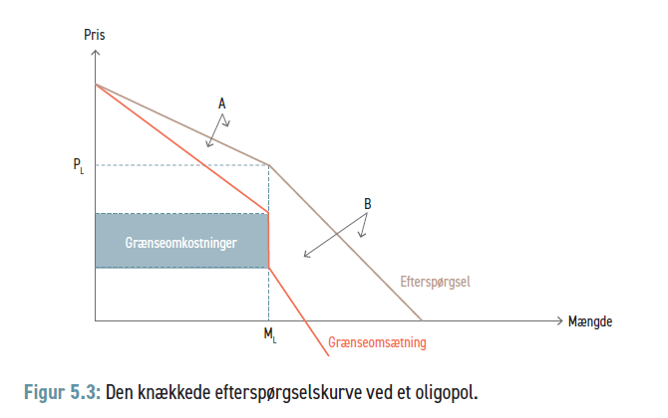
Mikroøkonomi
© Rune Peter Wingård

Slide 39
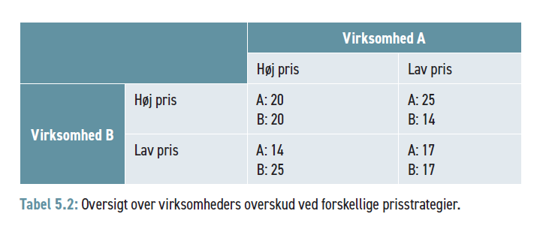
Mikroøkonomi
© Rune Peter Wingård

Slide 40
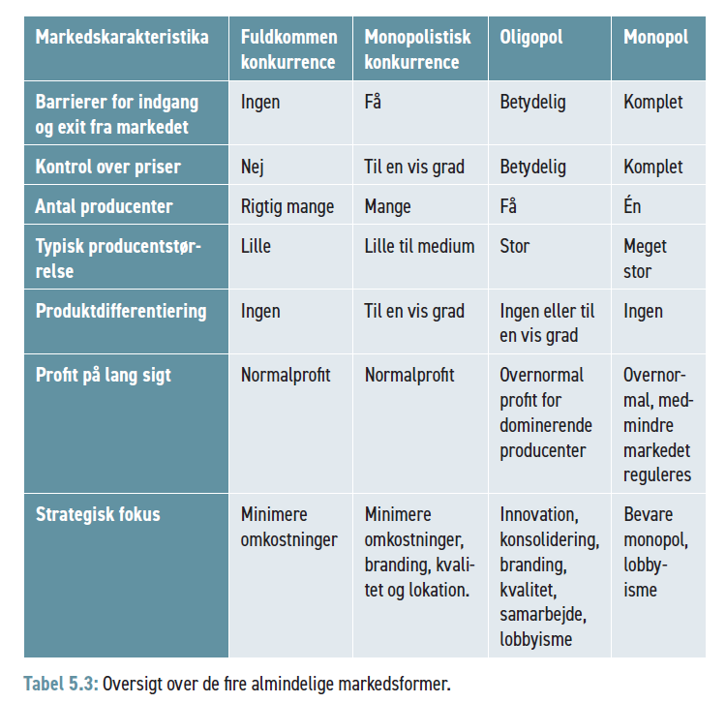
Mikroøkonomi
© Rune Peter Wingård

Slide 41
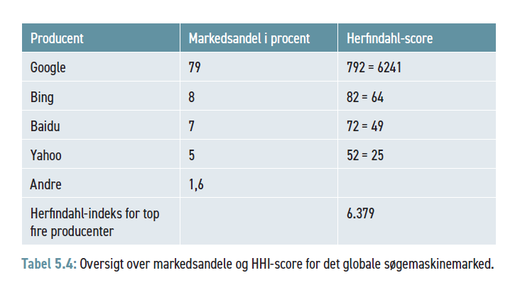
Mikroøkonomi
© Rune Peter Wingård

Slide 42
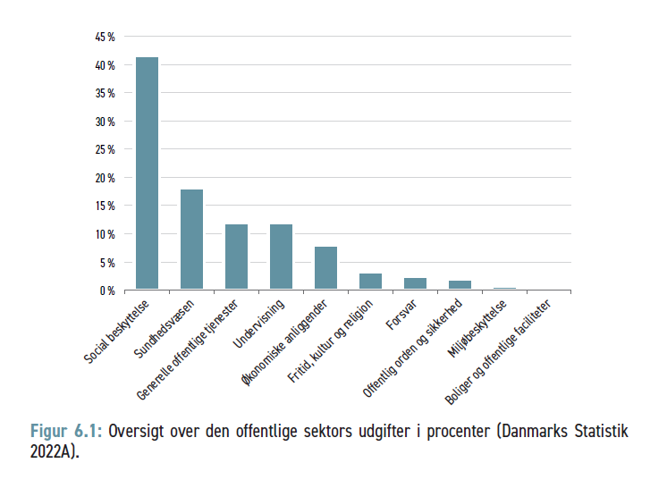
Mikroøkonomi
© Rune Peter Wingård

Slide 43
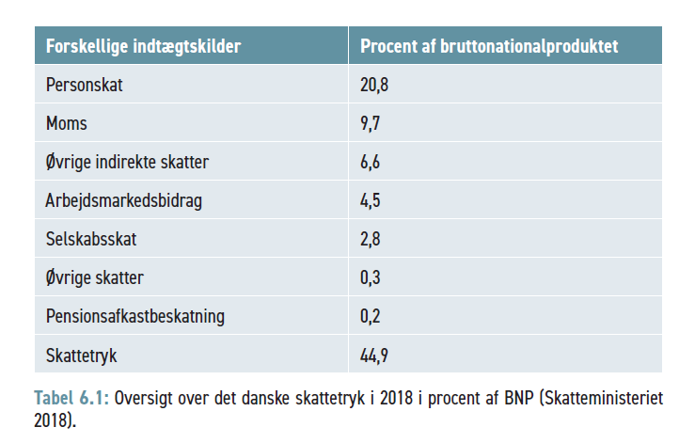
Mikroøkonomi
© Rune Peter Wingård

Slide 44
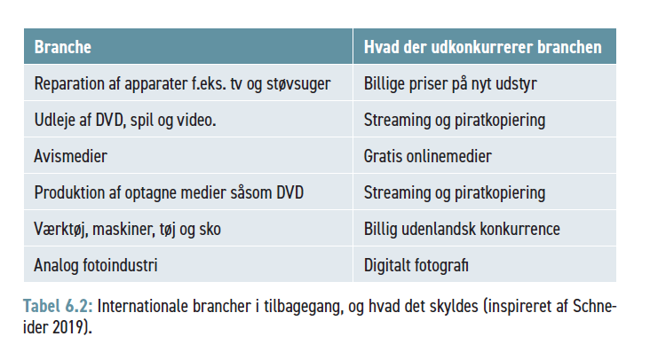
Mikroøkonomi
© Rune Peter Wingård

Slide 45
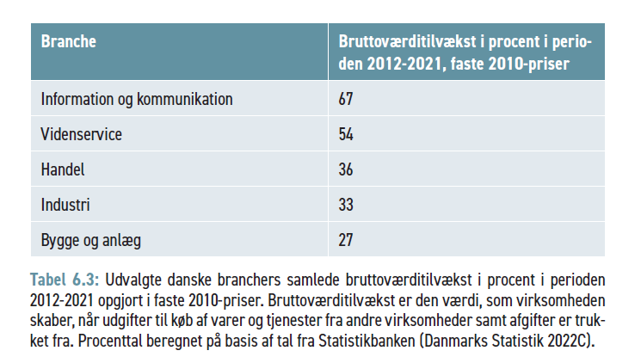
Mikroøkonomi
© Rune Peter Wingård

Slide 46
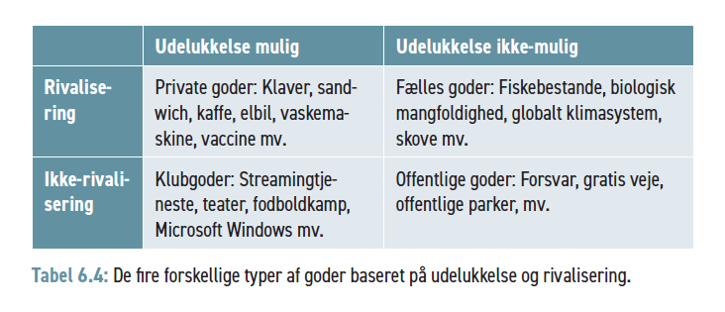
Mikroøkonomi
© Rune Peter Wingård

Slide 47
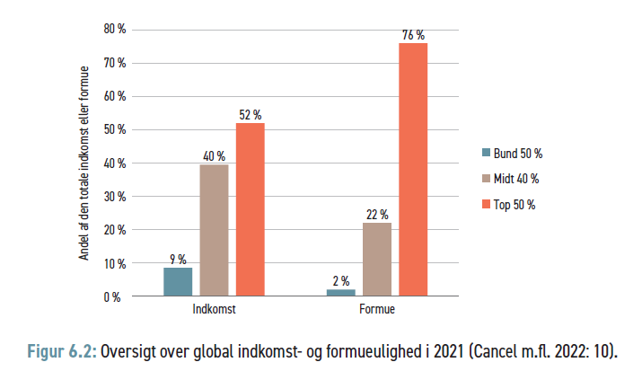
Mikroøkonomi
© Rune Peter Wingård

